Slide 1
Attribute Types

Slide 2
Simple
Composite
Single Valued
Multi Valued
Derived Attribute

Slide 3
Simple Attribute
The attribute which is not divided into sub parts.
Example – Customer_Id, Rollno

Slide 4
Composite Attributes
Composite attributes can be divided into smaller subparts, which represent more basic attributes with independent meanings of their own.
For example, the Address attribute of the employee entity can be subdivided into Street, City, State and Zip.
b
c
a

Slide 5
Multi Valued Attribute
A multivalued attribute may have upper and lower and upper bounds on the number of values for an individual entity.
For example, the colors attribute of a car may have between one and have five values, if we assume that a car can have at most five colors.

Slide 6
Derived Attribute
For example, the Age attribute of a person.
For a particular person entity, the value of age can be determined from the current date and the value of the person’s Birthdate.
The Age attribute is hence called a derived attribute and is said to be derivable from the Birthdate attribute, which is called a stored attribute.

Slide 7
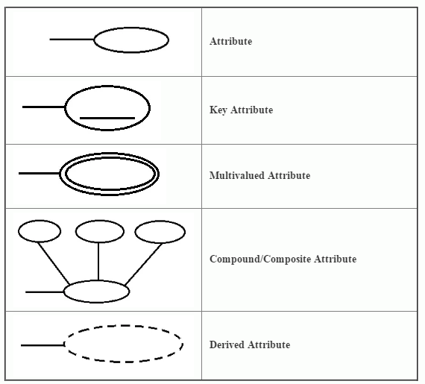
Notations Of Attributes in ER Diagram

Slide 8
Example of types of Attributes

Slide 9
middle
Street_Name
Last_name
First_name
Apartment_No
Street_no
name
Street
City
Cust_id
Address
State
customer
ZipCode
Phone_no
dateOfBirth
age

Slide 10
middle
Street_Name
Last_name
First_name
Apartment_No
Street_no
name
Street
City
Entity
Cust_id
Address
State
customer
ZipCode
Phone_no
dateOfBirth
age

Slide 11
middle
Street_Name
Last_name
First_name
Apartment_No
Street_no
name
Primary Key
Street
City
Cust_id
Address
State
customer
ZipCode
Phone_no
dateOfBirth
age

Slide 12
middle
Street_Name
Last_name
First_name
Apartment_No
Street_no
name
Street
City
Cust_id
Address
State
customer
Multi Valued
ZipCode
Phone_no
dateOfBirth
age

Slide 13
middle
Street_Name
Last_name
First_name
Apartment_No
Street_no
name
Street
City
Cust_id
Address
State
customer
Derived
ZipCode
Phone_no
dateOfBirth
age

Slide 14
middle
Street_Name
Last_name
First_name
Apartment_No
Street_no
name
Composite
Street
City
Cust_id
Address
State
customer
ZipCode
Phone_no
dateOfBirth
age

Slide 15
Sub parts of Name
middle
Street_Name
Last_name
First_name
Apartment_No
Street_no
name
Composite
Street
City
Cust_id
Address
State
customer
ZipCode
Phone_no
dateOfBirth
age

Slide 16
middle
Street_Name
Last_name
First_name
Apartment_No
Street_no
name
Street
City
Cust_id
Address
State
customer
ZipCode
Phone_no
dateOfBirth
age

Slide 17
middle
Street_Name
Last_name
First_name
Apartment_No
Street_no
name
Street
City
Cust_id
Address
State
customer
ZipCode
Phone_no
dateOfBirth
age

Slide 18
middle
Street_Name
Last_name
First_name
Apartment_No
Street_no
name
Street
City
Cust_id
Address
State
customer
ZipCode
Phone_no
dateOfBirth
age

Slide 19
middle
Street_Name
Last_name
First_name
Apartment_No
Street_no
name
Street
City
Cust_id
Address
State
customer
ZipCode
Phone_no
dateOfBirth
age

